Slide 1
Understanding Of Previous Year FPGA Project
Group:
Gavin Lewis 101617
Aditya Dsouza 101613
Shantanu Shinde 101651
TIFR- FCRIT

Slide 2
Precision Time Measurement with an Accuracy of Sub-Nanoseconds In Between Collisions

Slide 3
Abstract
The Compact Muon Solenoid (CMS) is a general-purpose detector at the Large Hadron Collider (LHC). It has a broad physics program ranging from studying the Standard Model (including the Higgs boson) to searching for extra dimensions and particles that could make up dark matter. The Compact Muon Solenoid (CMS) experiment is built on the Large Hadron Collider (LHC) at CERN in Switzerland and France. To have a good chance of producing a rare particle, such as a Higgs boson, a very large number of collisions are required.

Slide 4
Time to Digital Converter (TDC)
The aim of this project is to design a time-to-digital converter (TDC), especially intended to measure the delay between successive collisions in a collider with sub nanosecond accuracy. TDC being an important component of the CMS system is essential for accurate collision reconstruction and has great significance in collision detection.
The aim is to do so with the help of a Field Programmable Gate array (FPGA) device. Thus, the time-to-digital converter would be able to take any two signals (start and stop) and find the delay in between them to an accuracy of sub nanoseconds.

Slide 5
Existing Systems
For Coarse Measurement-
In its simplest implementation, a TDC is simply a high-frequency counter that increments every clock cycle.
The time interval T between start and stop for a clock cycle with frequency f is found to be,
T = nT₀
With n, the number of counts and T₀= 1/f the period of the reference clock.

Slide 6
Existing Systems (Continued..)
Limitations of Coarse Counter
The counter implementation accuracy is limited by the clock frequency. If time is measured by whole counts, then the resolution is limited to the clock period. For example, a 10 MHz clock has a resolution of 100 ns.
Greater the clock frequency more is the resolution and more are the number of readings captured. However, higher the clock frequency, higher is the power consumption for the generation and the processing of the clock signal.
To get resolution finer than a clock period, there are time interpolation circuits. These circuits measure the fraction of a clock period: that is, the time between a clock event and the event being measured.

Slide 7
Existing Systems (Continued..)
Fine Counter-
In contrast to the coarse counter, fine measurement methods measure with much better accuracy but far smaller measuring range.
1. Ramp Interpolator - When counting is not feasible because the clock rate would be too high, analog methods can be used. Analog methods are often used to measure intervals that are between 10 and 200 ns. These methods often use a capacitor that is charged during the interval being measured.

Slide 8
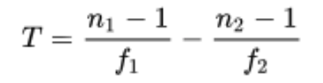
Existing Systems (Continued..)
2. Vernier Interpolator -
The Vernier method is a digital version of the time stretching method. Two only slightly detuned oscillators (with frequencies f 1 and f 2 ) start their signals with the arrival of the start and the stop signal. As soon as the leading edges of the oscillator signals coincide the measurement ends and the number of periods of the oscillators (n 1 and n 2 respectively) lead to the original time interval T:

Slide 9
Existing Systems (Continued..)
3. Tapped Delay Line -
In general a tapped delay line contains a number of cells with well-defined delay times. Propagating through this line the start signal is delayed. The state of the line is sampled at the time of the arrival of the stop signal. This can be realized for example with a line of D-flip-flop cells with a delay time. The start signal propagates through this line of transparent flip-flops and is delayed by a certain number of them. The output of each flip-flop is sampled on the fly. The stop signal latches all flip-flops while propagating through its channel un-delayed and the start signal cannot propagate further. Now the time interval between start and stop signal is proportional to the number of flip-flops that were sampled as transparent.

Slide 10
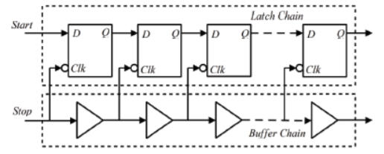

Slide 11
Existing Systems (Continued..)
Hybrid Approach -
Counters can measure long intervals but have limited resolution. Interpolators have high resolution but they cannot measure long intervals. A hybrid approach can achieve both long intervals and high resolution.

Slide 12
Approach
Approach followed in developing the project.

Slide 13
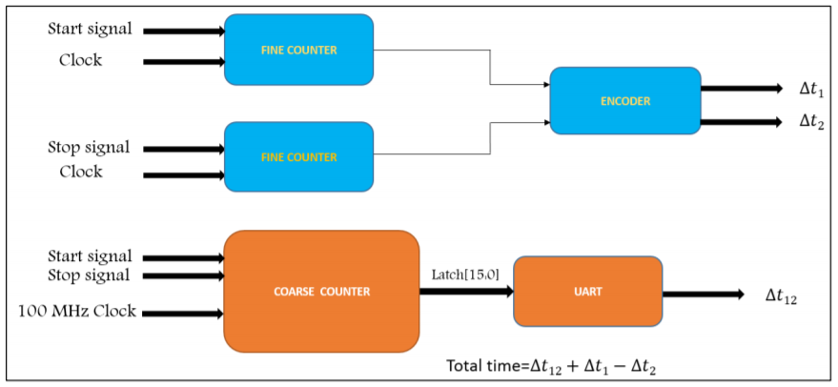
Block Diagram

Slide 14
